Slide 1
Application of business analytics in real-world
David mo, Jessica xing

Slide 2

agenda
Background: Predictive analytics
Challenges in the real world
Case study Air B&B in New York City

Slide 3
KEY CONCEPT
Statistical modeling: finding relationship between variables and significance of those relationships. The main concern is interpretation of models. No test set is involved
Linear regression
Hypothesis testing
Predictive analytics: analyze current and historical facts to make predictions about future or otherwise unknown events. The main concern is performance of model in predicting outcome, not the model itself. A test set is used to evaluate the model
Data mining
Machine learning/Deep learning
Notes:
the point of statistical modeling is to characterize the relationship between the data and our outcome variable, not to make predictions about future data. We call this procedure statistical inference, as opposed to prediction. However, we can still use this model to make predictions but the way the model is evaluated will not involve a test set and will instead involve evaluating the significance and robustness of the model parameters.
The purpose of (supervised) machine learning is obtaining a model that can make repeatable predictions. We typically do not care if the model is interpretable. All we care is the result. We typically evaluate the machine learning algorithm with test set

Slide 4
Challenges in real world
Data is not collected for your model
Don’t know what question to ask
Stake holders only care about the result

Slide 5
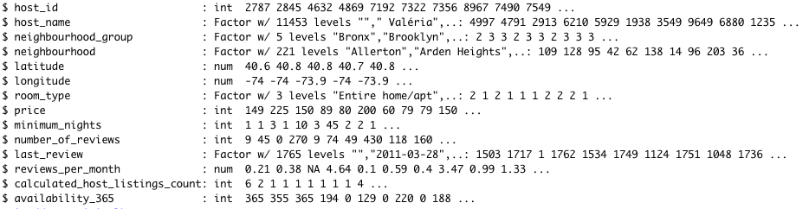
Air B&B in new York city

Slide 6
Visualization

Slide 7
Model1
Purpose: Using neighborhood group, number of reviews, room types to make binary classification of price
80% of data is used to train model, 20% is used to test model
Using binomial logistic regression

Slide 8
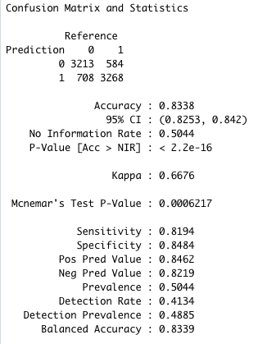
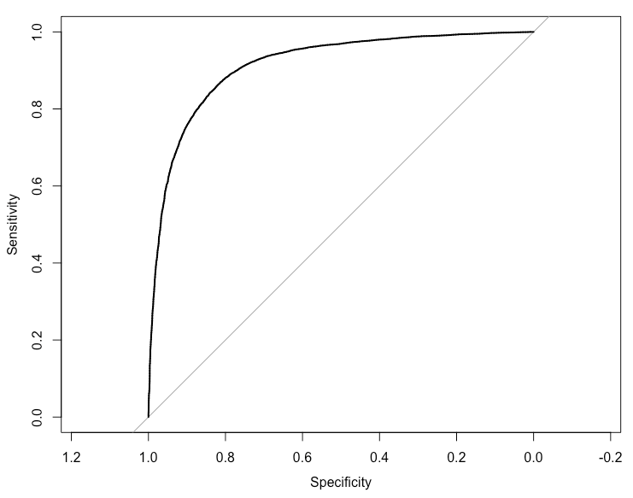
Confusion Matrix
AOC Curve

Slide 9
Model2
Purpose: Using neighborhood group, number of reviews, room types, price to make binary classification of number of review (measure of popularity)
80% of data is used to train model, 20% is used to test model
Using binomial logistic regression

Slide 10
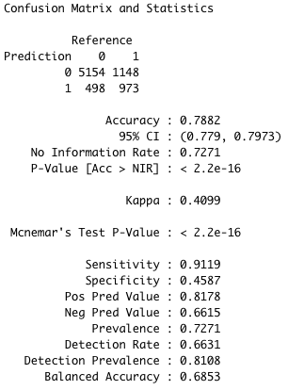
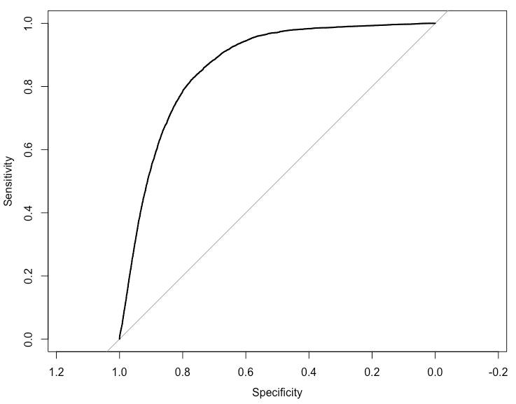
Confusion Matrix
AOC Curve

